Slide 1
Bank Marketing Campaign Analysis and Prediction
Presenters: Aliyu , David, Eriel and Indu

Slide 2
Overview
The primary objective of this project is to analyze and predict customer responses to a bank’s marketing campaigns.
This project involves developing classification machine learning models to predict whether a customer will subscribe to a term deposit based on their demographic and campaign data.
The insights from this analysis can help the bank optimize its marketing strategies, improve customer targeting, and enhance campaign effectiveness.

Slide 3
Dataset Overview
Source: UCI Machine Learning Repository
The chosen bank marketing dataset consists of information about marketing campaigns of a Portuguese banking institution. The data is related to the direct marketing campaigns (phone calls) made to the bank clients. https://archive.ics.uci.edu/dataset/222/bank+marketing
Records: 41,188
Target Variable: `y` - binary variable indicating whether the client subscribed to a term deposit: “yes” or “no”
Features: 20 Attributes containing demographics, economic context and campaign data
Refer to Appendix for all the attributes

Slide 4
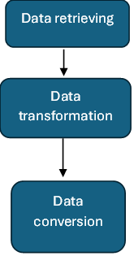
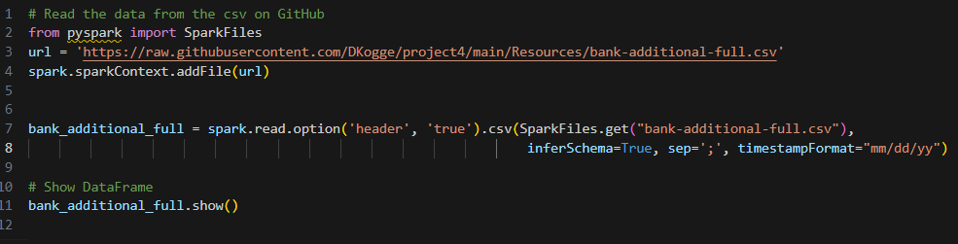
Data Preprocessing
Steps
Retrieve the data from the UCI Machine Learning Repository.
Upload the data to GitHub repository.
Read the data from the CSV file on GitHub for cleaning and validation using Spark SQL as our primary tool for data extraction.

Slide 5



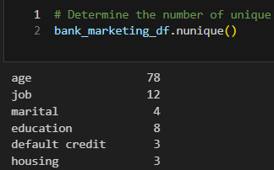

Data Preprocessing
4. In the transformation process we:
a. Filled all missing values by 0
6. Save the DataFrame as a CSV for visualization
b. Rename the default column to default credit
7. Checking the value of different columns to replace it with Other in order to normalize our data frame.
5. Convert the PySpark DataFrame to a Pandas DataFrame

Slide 6
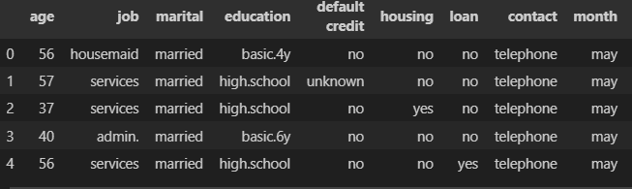
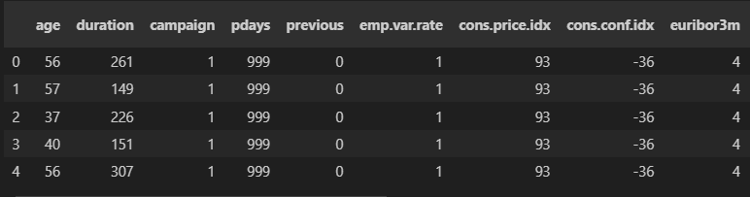
Data Preprocessing
8. Convert our categorical data to numeric using ‘ pd.get_dummies’
Dataframe before preprocessing
Dataframe after preprocessing

Slide 7
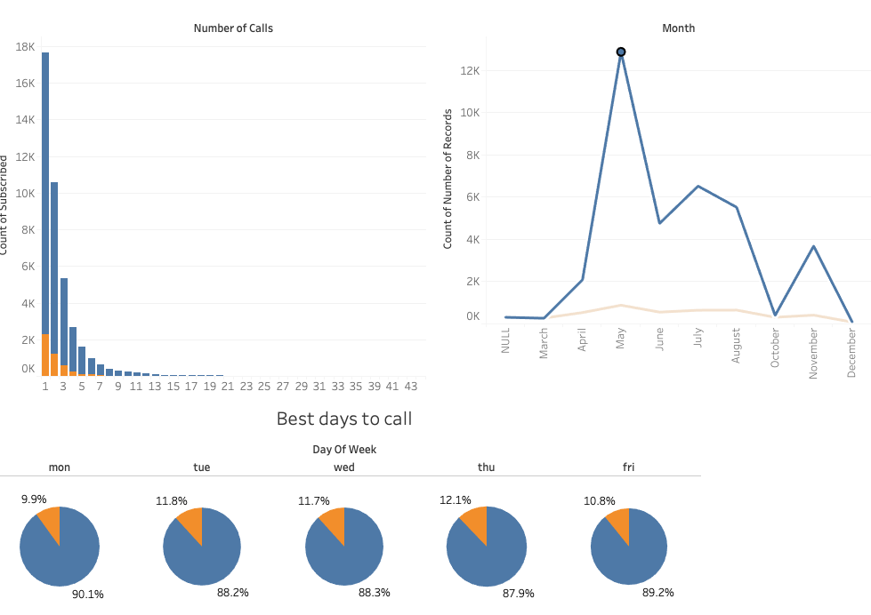
Exploratory Data Analysis and Visualization
The analysis shows that the majority of subscriptions come from people who are called once, with the best days to call being Wednesdays, and Thursdays in the month of May

Slide 8
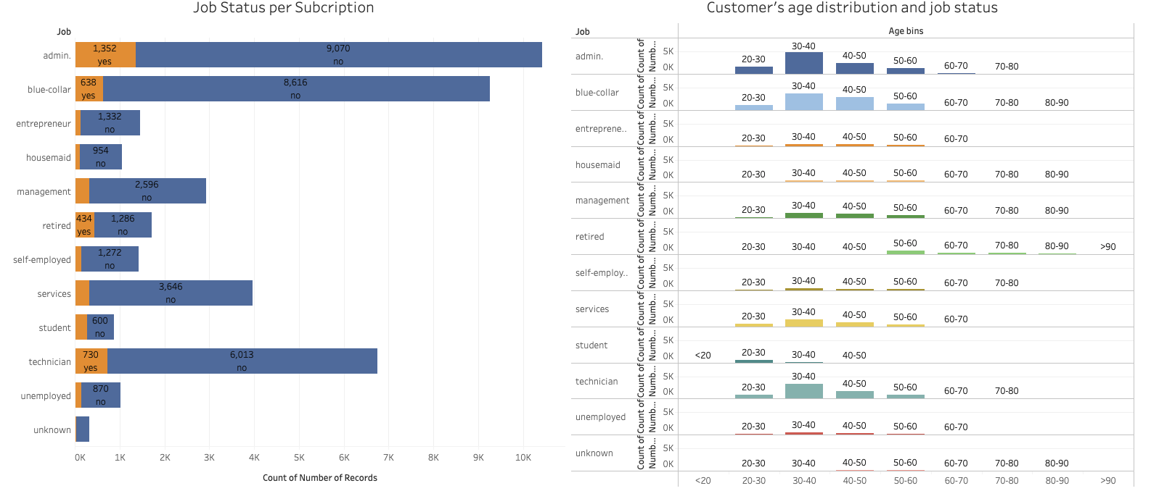
Exploratory Data Analysis and Visualization Contd
By understanding the high subscription rates among 30-40 year-old ‘Admin’ employees and recognizing their responsiveness to outreach efforts, businesses can strategically focus their marketing and sales efforts to maximize engagement and subscriptions from this key demographic

Slide 9
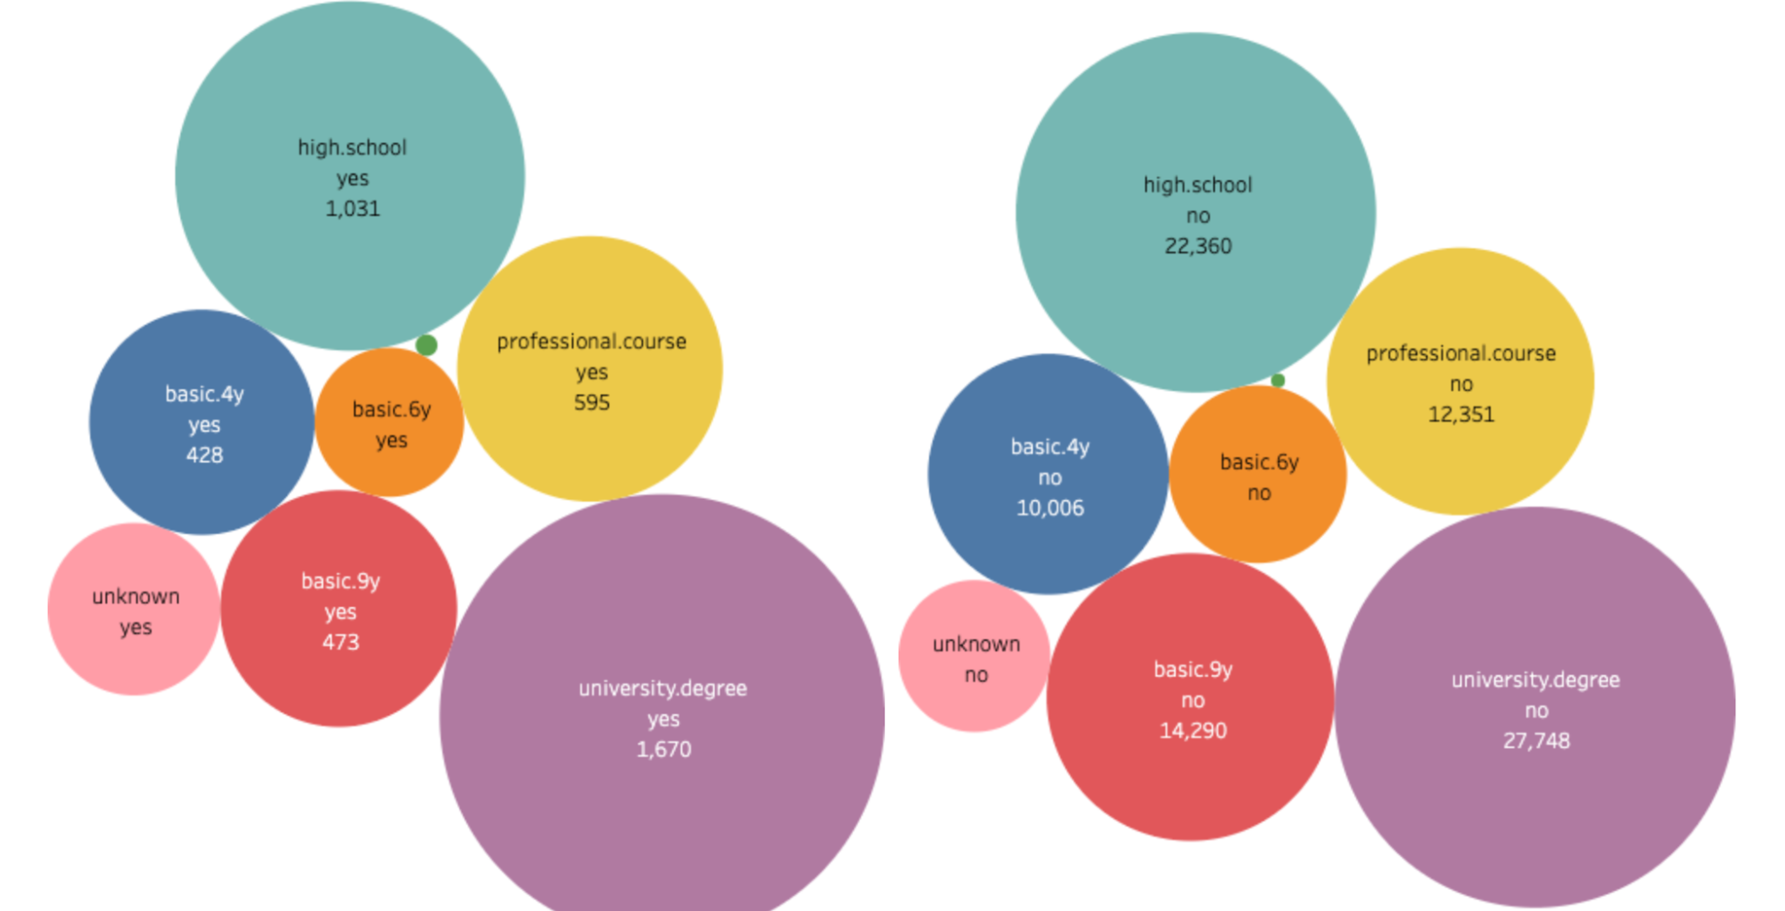
Exploratory Data Analysis and Visualization Contd
From this analysis, it is clear that individuals with a university degree are the most subscribed. This indicates that for higher subscription rates, targeting people with a university degree would be most effective

Slide 10
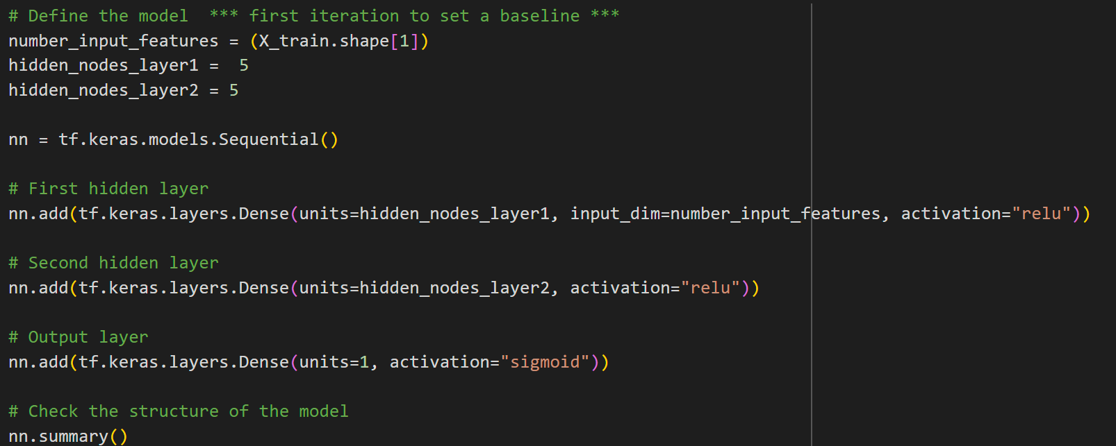
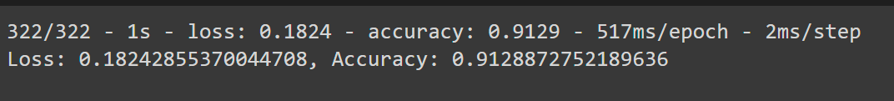
Model Building and Training
First Tensorflow Sequential model and results
Notes:
Baseline model, used relu and 2 layers with 5 neurons in each layer. Achieved 91.28% accuracy.

Slide 11
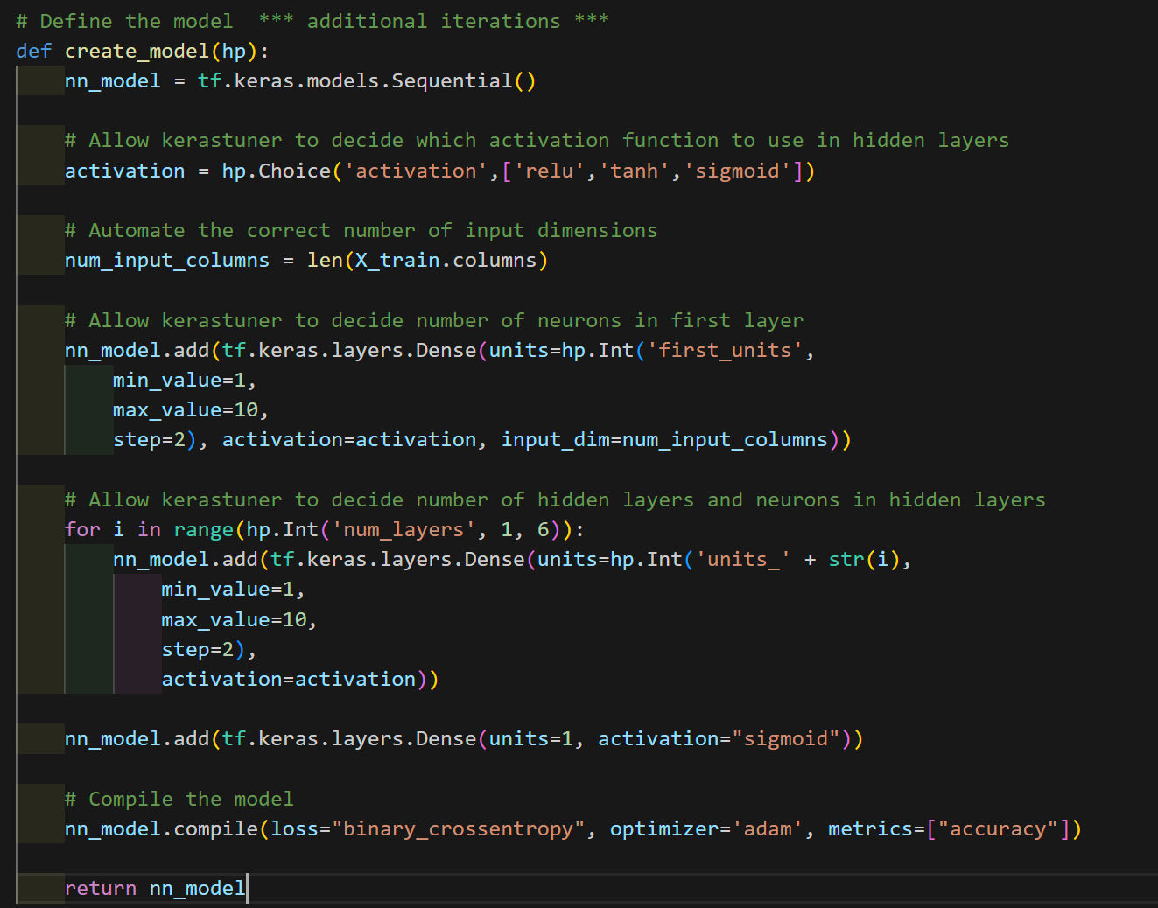
Model Optimization
Keras Tuner - Auto Optimization
Notes:
Used the Keras Tuner to run an auto optimization model with the choice of activation functions and hidden layer number up to 10 and neurons up to 10.

Slide 12
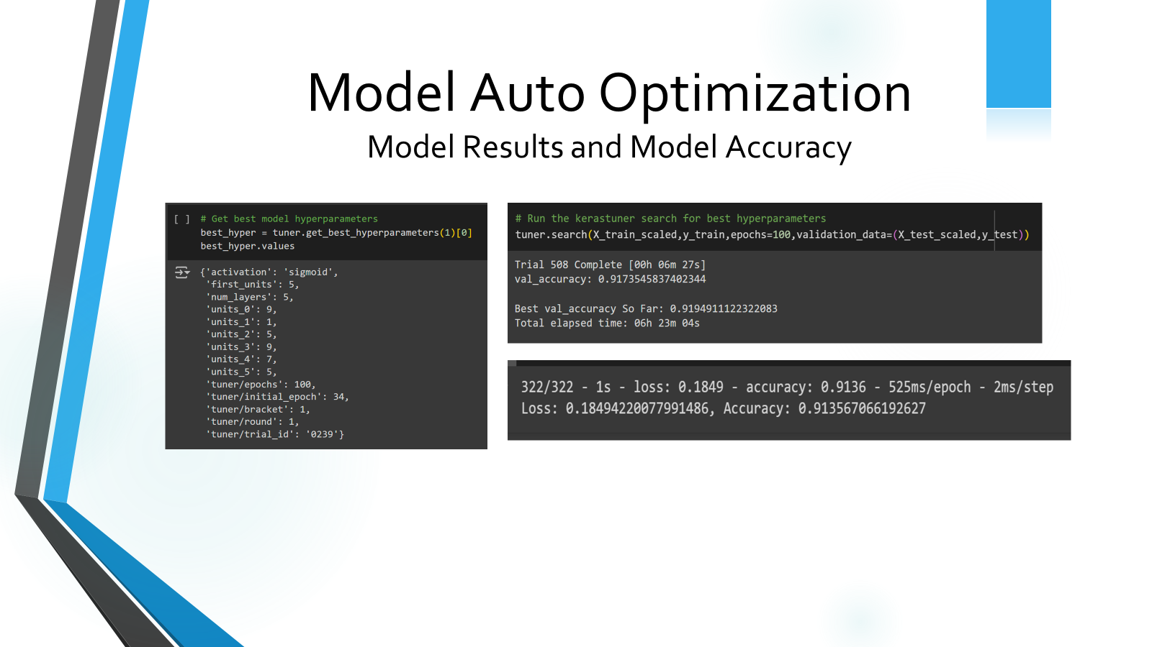
Notes:
results: Sigmoid 5 layers - 91.36%

Slide 13
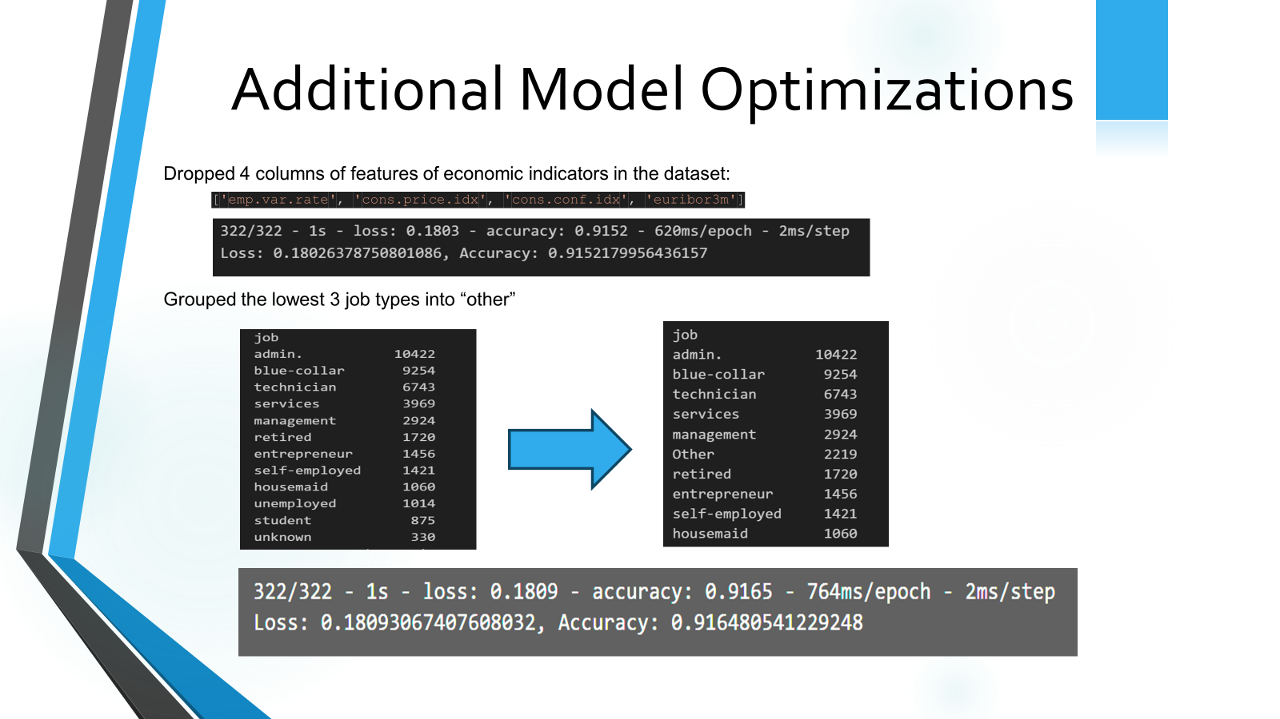
Notes:
Ran quite a few other optimizations that did not achieve better results, but these 2 did increase the accuracy slightly

Slide 14
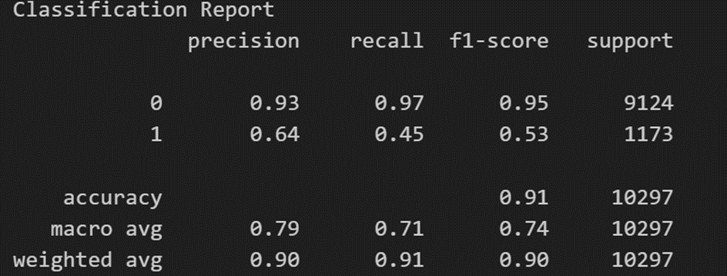
Model Optimizations
Random Forest Model
Model has an accuracy of 91% and performs very well in predicting customers who do not enroll for a term deposit with high precision of 93% and 97%.
Model’s performance is lower in identifying customers who can sign up for a term deposit since it significantly misses the number of actual customers as the precision is at 64%.

Slide 15
Limitations
• Ran into issues with the max processing limit in the free version of Colab, several model runs had the connection broken 4+ hours into the run. Would recommend the paid version and more resources dedicated to future model research.
• Noticed an imbalance in the testing dataset with a higher number of clients with term deposit (9124) compared to non-depositors (1173) in random forest classification model.
Next Steps
• Analyze the dataset using other classification models like Logistic Regression, Decision Trees.
• Predict the continuous outcomes such as the amount a customer might deposit using Linear Regression Model

Slide 16
Conclusion
The machine learning models we generated were able to predict results with 91% accuracy. While not perfect, we felt this was a excellent tool for this bank to use for their future marketing campaigns.

Slide 17
Appendix
Input variables:
age
job: type of job
marital: marital status
education
default: has credit in default?
housing: has housing loan?
loan: has personal loan?
contact: contact communication type
month: last contact month of year
day_of_week: last contact day of the week
duration: last contact duration, in seconds
campaign: number of contacts performed during this campaign and for this client
pdays: number of days that passed by after the client was last contacted from a previous campaign
previous: number of contacts performed before this campaign and for this client
poutcome: outcome of the previous marketing campaign
emp.var.rate: employment variation rate - quarterly indicator - indicates change in employment levels over a quarter
cons.price.idx: consumer price index - monthly indicator - measures the average change in prices paid by consumers for goods and services
cons.conf.idx: consumer confidence index - monthly indicator - measures the consumers overall state of the economy
euribor3m: 3-month Euribor rate - daily indicator - rate at which eurozone banks offer to lend unsecured funds to other banks for a period of 3 months.
nr.employed: number of employees indicating the employment level in the economy
Output variable:
y: has the client subscribed a term deposit?

Slide 18
Appendix
References:
Attribute definitions - https://archive.ics.uci.edu/dataset/222/bank+marketing https://www.kaggle.com/code/jaimebecerraguerrero/bank-marketing-data-analysis-eda-0-9-score
Keras Tuner - https://www.tensorflow.org/tutorials/keras/keras_tuner
Google Colab - https://research.google.com/colaboratory/faq.html
Tableau - https://public.tableau.com/views/Bank_Marketing_17176507235630/OutreachingEmployees?:language=en-GB&publish=yes&:sid=&:display_count=n&:origin=viz_share_link

